Slide 1
Feature Selection
Practical assignment

Slide 2
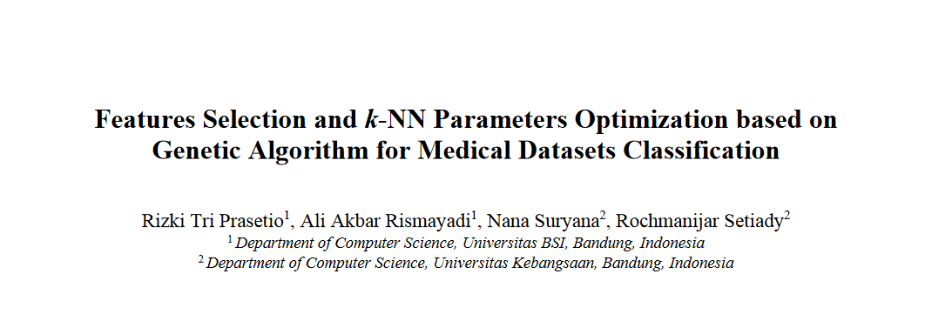
Feature selection for KNN using ES

Slide 3

Evolution Strategies ((μ,λ)-ES)
EVOLUTIONARY ALGORITHMS
Mutation parameter μ
$$m\sim G(p,σ)$$
1/5 success rule
Self-adaptive mutation step
Single-Step-Size mutation
the ratio (denoted as φ) of successful mutations (ones which produce a
child of higher fitness than its parent) to the total number of mutations is
measured periodically during the optimisation run, with σ being altered as
necessary in order to approach a ratio of 1/5.

Slide 4
Problem
Implement a wrapper strategy to extract the set of best features for a KNN classification using an ES algorithm.
Run the algorithm 10 times. Do you get the SAME markers at each iteration? Is there a subset of markers that consistently appear in the final solution? What does this mean? Write your answers at the end of the script that you have to provide.
COMMENT EACH LINE OF YOUR CODE. If the function you are using has parameters, EXPLAIN what is doing each parameter. NOT properly commenting the solution can reduce by 50% the final mark!

Slide 5
Problem
Comment each line of code with useful comments (i.e. avoid things such as “I do a loop” or “initialize the variable a”. Explain WHY you do a loop or which is the purpose of variable a!)
Practical assignment is INDIVIDUAL. NO sharing code is allowed ( = same code, same 0 grade).
Practical assignment is compulsory. No grade, NO final grade…
To provide: A script with your code in R and the answers to the questions (also at the end of the script, as if they were comments).

